Slide 1
Overall Bundle:
Intervention: Smoking Cessation Program
Incentive: Program Discounts
Policy Type: Whole Life
Is the person older than 45?
Yes
Intervention: Smoking Cessation Program
Incentive: Program Discounts
Yes
Is the person a smoker?
No
Overall Bundle:
Intervention: Smoking Cessation Program
Incentive: Program Discounts
Policy Type: Term Life
No
Intervention: Heart Screening
Incentive: Premium Reduction
Overall Bundle:
Intervention: Heart Screening
Incentive: Premium Reduction
Policy Type: Whole Life
Is the person older than 45?
Overall Bundle:
Intervention: Preventative Screening
Incentive: Lump Sum
Policy Type: Term Life
Intervention: Preventative Screening
Incentive: Lump Sum (Cash Back)

Slide 2
Overall Bundle:
Intervention: Smoking Cessation Program
Incentive: Program Discounts
Policy Type: Whole Life
Is the person older than 45?
Yes
Intervention: Smoking Cessation Program
Incentive: Program Discounts
Yes
Is the policyholder older than 45?
No
Overall Bundle:
Intervention: Smoking Cessation Program
Incentive: Program Discounts
Policy Type: Term Life
No
Intervention: Heart Screening
Incentive: Premium Reduction
Overall Bundle:
Intervention: Heart Screening
Incentive: Premium Reduction
Policy Type: Whole Life
Is the person older than 45?
Overall Bundle:
Intervention: Preventative Screening
Incentive: Lump Sum
Policy Type: Term Life
Intervention: Preventative Screening
Incentive: Lump Sum (Cash Back)

Slide 3
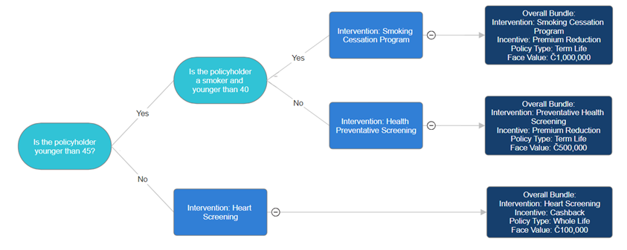

Slide 4
5
Intervention Parameter Error
4
Rate Fluctuations
3
Severity
2
Regional Disparity + Reputation
Moral Hazard
1
1
2
3
4
5
Likelihood

